Slide 1

S.NO: 1
YEAR: 2021
AUTHOR NAME : Humberto M. Beneduzzi1
Eduardo G. de Souza2
Wendel K. O. Moreira2
Ricardo Sobjak3
Claudio L. Bazzi3
Marlon Rodrigues2*
PROJECT TITLE:
.
FERTILIZER RECOMMENDATION METHODS FOR PRECISION AGRICULTURE – AI
SYSTEMATIC l ITERATURE STUDY
ABSTRACT :
* Increase agriculture yield
*Studice analyes the five domains –precision agriculture- soil fertilizer, site specific nutrient
application, fertilizer,recommendation method and recommendation software,for site –specific
nutrient application
*Based on that 12 methods for N and nine method recommending P six for recommendation for K
DESIGN METHODOLOGY :
Nitrogen recommendation method using ” OPTICAL SENSORS”

Slide 2
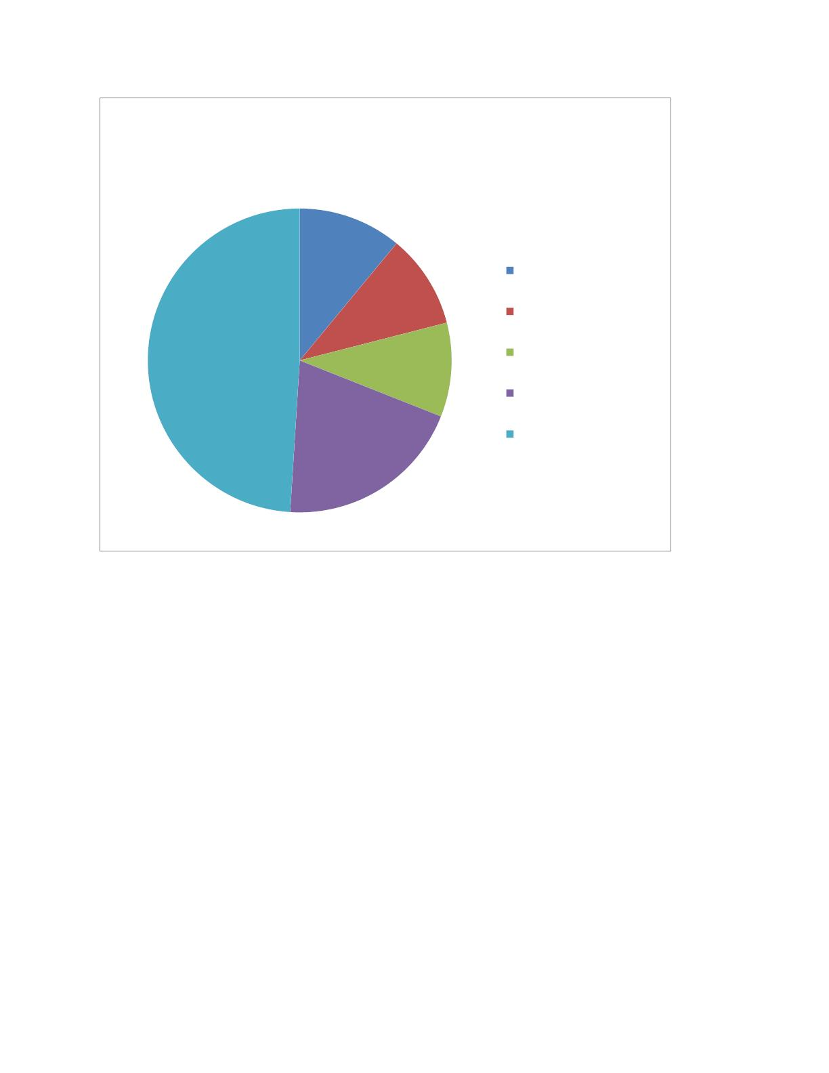
Percentage of articles by the predominance
of subjects
11%
software for variable rate
application recommend
10%
precision agriculture
49%
10%
soil fertility
variable rate application
fertilizer recommend
20%
*Software for variable rate application recommend.: 11%
* Precision agriculture: 10%
* Soil fertility:10%
* Variable rate application: 20%
*Fertilizer recommend. methods: 49%
FINDING FOR EVALUATION:
To detetmine the fertilizer rate for a particular nutrient ,multiply rate of the desired nutrient
by 100 and divide by the % of the nutrient in the fertilizer
ADVANTAGES:
* Reduction in cost of cultivation
*Increase in production efficiency
*Increase in RUE

Slide 3
*Reduction in environmental pollution
*Erosion control
DISADVANTAGES:
*Initial capital costs may be high and so it should be seen as a long-term inverstment
*It may take several years before you have sufficient data to fully implement the system
*Extremely demanding work particularly collecting and then analyzing the data
S.NO: 2
YEAR:2022
AUTHOR NAME:
.Dr.S.UshaKiruthika2Dr.S.Kanaga Suba Raja3S.R.Ronak, 4S.Rengarajen, 5P.Ravindran
1Department of Computer Science and Engineering SRM Institute of Science and TechnologyChennai,
India.
2345Easwari Engineering College Chennai, India.
PROJECT TITLE:
DESIGN AND IMPLEMENTATIONOF FERTILIZER
RECOMMENDATIONSYSTEM FOR FARMERS
ABSTRACT :
✓ This paper introduces a compelling technique for
estimation of nutrient dimension in soil and suggestion for appropriate fertilizer.

Slide 4
✓ India is an agrarian nation. But creating a profitable yield for the farmer in each crop cycle is
becoming a major challenge on various factors. Picking the reasonable fertilizer for the landand
yield is an important and basic part of agriculture. Deciding the supplement levels in
soil utilizing lab hardware can be restrictively costly, particularly in developing nations.
✓ The soil sample is analyzed using an IoT based device
utilizing NPK sensor with two electrodes are set to calculate collect the NPK ratio of the soil
nutrient and for pre-processing, the data gathered from sensors are figured into correct
dataset and machine learning algorithm is utilized to recognize the reasonable fertilizer.
•
•
•
Chemical
Organic
Biofertilizers
Organic fertilizers: Organic fertilizers are mainly made by elements that occur
in nature or end product of natural material. Like most of the other fertilizers, it
also provides basic nutrients of the plant which are potassium, nitrogen, and
phosphorus. Organic fertilizers increase a lot of soil organisms which helps to
boost plant growth.
Biofertilizers: Microbial inoculants or biofertilizers help fix the soil elements
by non-usable to usable form through the biological process. These fertilizers are
microorganisms like bacteria, algae, and fungi which help in fixing the soil
atmosphere and convert potassium phosphate into a soluble form so that soil can
absorb it to boost plants.
❖ Chemical fertilizers: The macronutrients nitrogen, phosphorus, and
potassium are mainly present in chemical or inorganic fertilizers. This
chemical fertilizer is mostly used because it is easily soluble and boosts the
growth of the crop instantly.
DESIGN METHODOLOGY:
1.INTRODUCTION
India is a horticulture based country and agriculture
is considered as the key for human progress since
ancient times. Farming part has a vital job in Indian
economy, Agriculture division an unquestionable
requirement for GDP development in India and
furthermore Agriculture gives the foremost methods
for work for more than 60 percent of India's

Slide 5
populace. But in the recent years due to multiple
fertilizers present in market, farmers gets confused
and apply the fertilizer famous around his locality
without second thought.
The second phase is
preprocessing of data using java calculating the data
from the sensors and formulating them in the dataset
and saving the data in the cloud and encrypting them
in SHA algorithm for security purposes. The third
phase is the classification of the soil quality with the
similar data present in the database.
2.RELATED WORKS
Each element has an absorption wavelength of light,
In [1], the authors has proposed an methodology in
which a light beam with absorption wavelength of
the nutrient will be passed on the soil sample to
detect the intensity of the light reflected and find
range of voltage for classifying the nutrient content
as high, medium and low. In [2], the authors suggest
the approach of using UV spectrophoto sensor
which calculates the a intensity of the passed UV
light to the soil solution and the intensity of the light
before passing the soil solution to calculate the
absorbance using Beer’s law to estimate the content
of the nutrient in the soil sample. In [3], author
explains about using fiber optics, humidity,
temperature and sunlight sensor estimate the NPK
values of soil and other parameters and pass it to the
microcontroller to remotely control the work in the
agriculture field such as fertilization, pumping of
water depending on the sensor readings. This paper
gives the basic structure for smart agriculture.

Slide 6
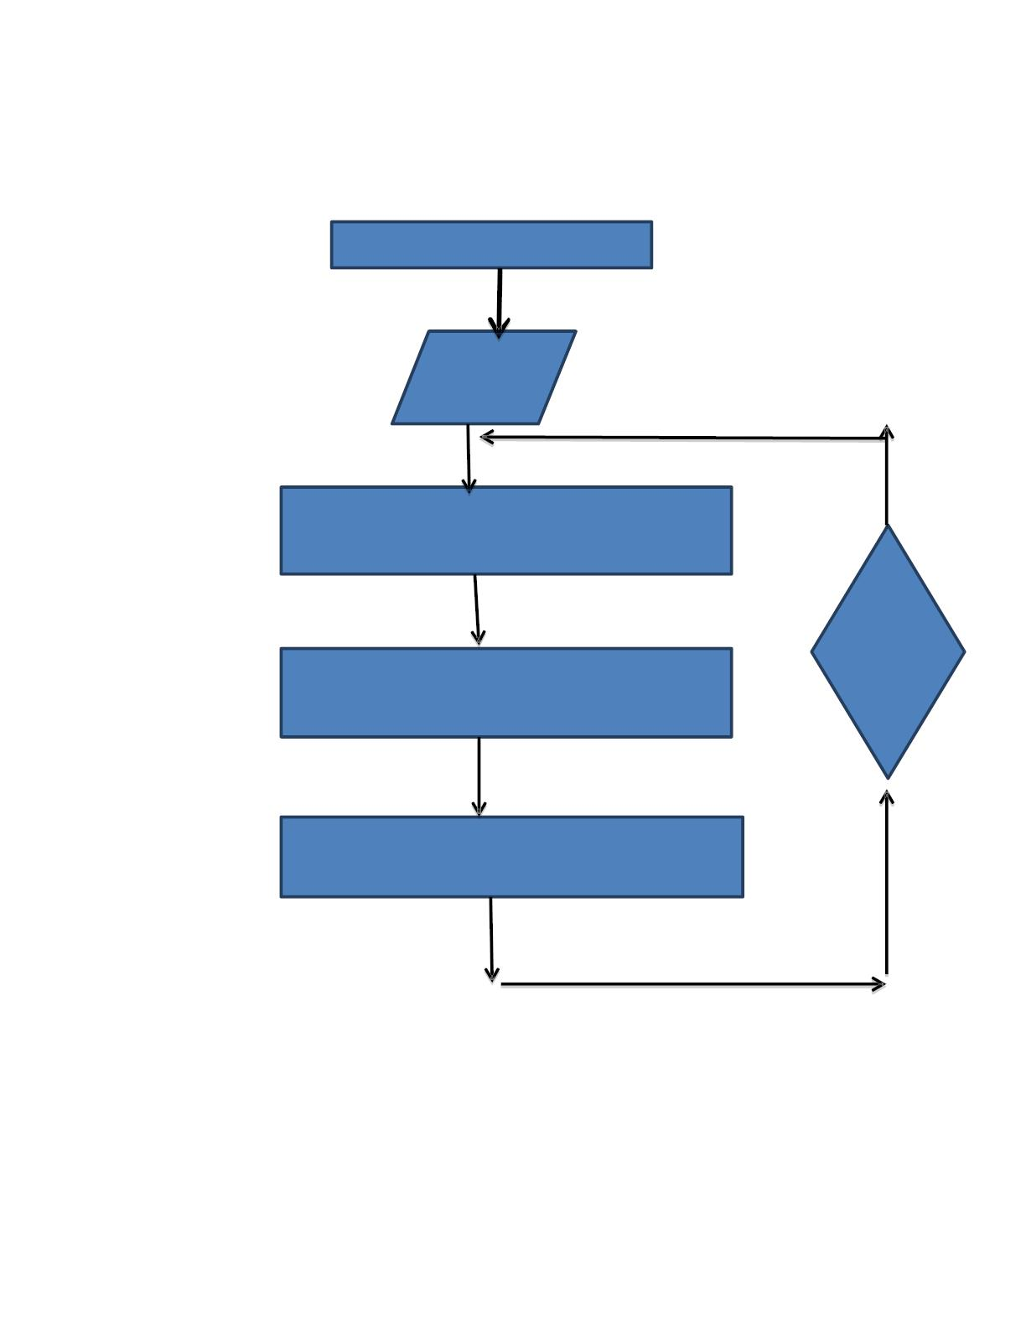
3.OVERVIEW OF PROPOSED SYSTEM
start
Number of
cluster k
Find the centroids of the data
no
object
move
group
Calculate the distance between the same data
And each centroid
Group of the data with the
Nearest cluster
4.HARDWARE SETUP
Soil sample is collected in a small bowl for analysis.
The NPK sensor used has two electro chemical
diodes which should be immersed in the soil sample.

Slide 7
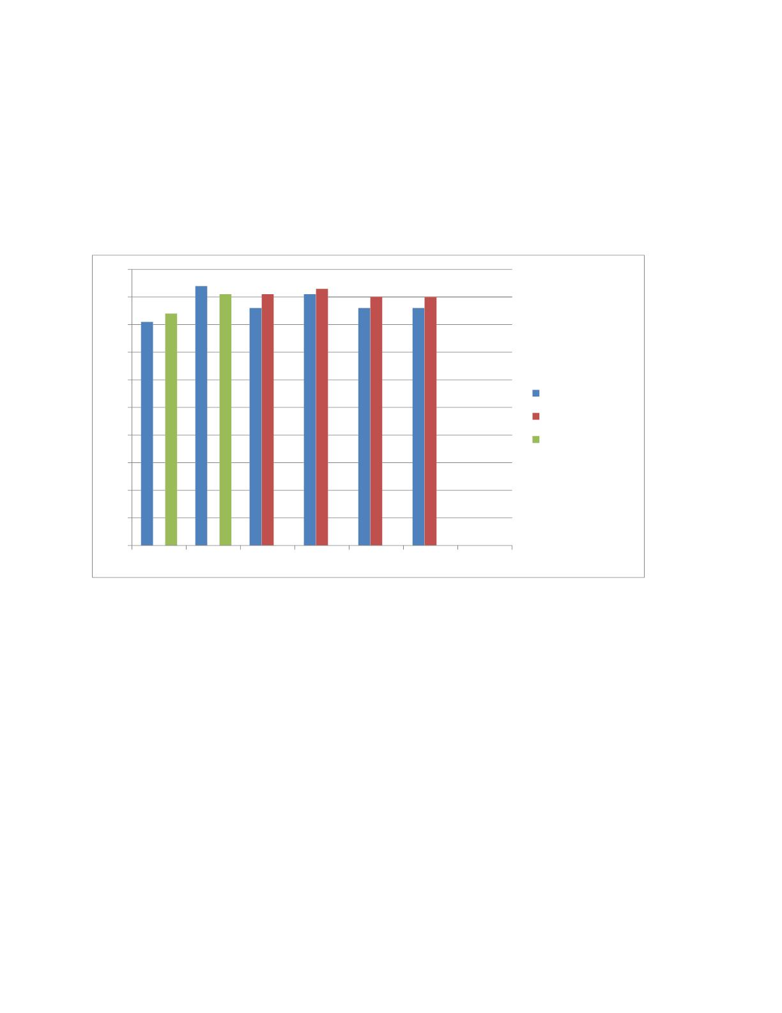
The diodes will calculate the ions movement in the
soil and produce the total nutrient content in the soil
as a ppm. The individual npk ratio will be calculated
later with the ppm value.
100
90
80
70
60
50
40
nutrient analysis
existing
proposed system
30
20
10
0
accurancy precision accurancy precision
recall
fscore
FINDING FOR EVALUATION:

Slide 8
❖ In fertilizer evaluation, the percentage content of the common nutrient of concern is
invariably known for each fertilizer. As a result, the fertilizer applica tions can be
expressed on the basis of quantities of the nutrient instead of quantities of fertilizer
❖ The diagnosis of the nutrient status of the soil by using different techniques or
methods is known as soil fertility evaluation in this papper provides mpre evaluation for
this project.
ADVANTAGES:
The results show that organic fertilizer could increase the farmer’s
income
fertilizers that can be organic or inorganic but helpful to boost the
plant’s health and its growth.
Easily Available: As the fertilizers are very helpful in fast
improvement in plants and best for agricultural production its
demand also increases but many factories are working constantly to
reach the demand. Thus now all the types of fertilizers are easily
available in the market.
❖ Fast absorptio
DISADVANTAGES:
❖ other living beings plants also need some nutrients for their proper growth and
development. Sometimes it becomes difficult to get all the elements from soil .
❖ Expensivelyhigh
❖ Reduce soil quality

Slide 9
S.NO:3
YEAR:2020
AUTHOR NAME:
PORJECT TITLE: Application of Different Fertilizer Types and
Levels on Vegetable Production:CRITICAL REVIEW
ABSTRACT:
Types and levels of fertilizer applied to crops are very important in crop production and play an
important role in cropping systems. Relying on inorganic or chemical fertilizers is a major constraint due
to its prohibitive cost though identified as an important factor in meeting the food requirements of a
growing population. In recent years there is a growing trend to reduce the use of mineral fertilizers,
especially soil applied nutrients such as nitrogen (N), phosphorus (P) and potassium (K) and their use
had decreased by seven times. Moreover, there is also increasing demand for organically-grown farm
products. These create preconditions to recognize the importance of foliar fertilization and the use of
organic fertilizers as an alternative to meet plant nutrient demand during the growing season [25]. Foliar
fertilization is an important tool for the sustainable and productive management of crops. In recent
years, foliar fertilizers, especially organic ones, have proliferated in the agricultural fertilizer market [15].
Interest on foliar fertilization has risen because of the many advantages of the methods of application of
foliar nutrients, such as rapid and effective response to plant needs, regardless of soil conditions [25].
However, few studies have been conducted to compare the effects of both ground and foliar application
of fertilizers
DESIGHN METHODOLOGY:

Slide 10

1. History of Plant
Mineral
Nutrients
For the plants to complete a normal growth, seventeen (17) elements are required. C, H and O are taken
from water and air.
Primary nutrients are used by plants in comparatively large quantity and often complemented as
fertilizers (Nitrogen, Phosphorus and Potassium). On the other hand, secondary nutrients like Ca, Mg
and S are also utilized in large quantity but sufficiently supplied and are normally readily available.
Micronutrients (trace elements) are required in minute quantity. Micronutrients nutrients are Fe, Zn,
Mo, Mn, B, Cu, Co and Cl [41]. Glimpses of early history for research starting on essential nutrients for
plant growth emerged in literature, which demonstrate that crop nutrition experiments were carried
out by a Greek Philosopher Theophrastus during 287-372 BC. Later on several scientists performed a
long chain of experiments to be familiar with the significance of mineral nutrients for normal growth of
plants. Hence, it appears that plant nutrition is possibly one of the earliest phases of quantitative study
of plant physiology [22].
2.Organic, Inorganic, and
Foliar Fertilizers Application
[16] stated that foliar fertilization is an agricultural practice of increasing importance. In theory,
application of nutrient sprays may indeed be an environmentally friendly fertilization method since the
nutrients are directly delivered to the plant in limited amounts, thereby helping to reduce the
environmental impact associated with soil fertilization. However, response to foliar sprays is often
variable and not reproducible due to the existing lack of knowledge of many factors related to the
penetration of the leaf-applied solution
This fact causes farmers to shift to either organic fertilizers or inorganic fertilizers. [9] reported that
organic fertilizer increases the cation exchange capacity of the soil. Aside from its ability to supply
nutrients, organic fertilizers are also capable of improving the physical, chemical, and biological
properties of soil which could significantly improve the growth and development of plants. [37] pointed
out that organic matter is an excellent source of plant-available nutrients and their addition to soil could
maintain high microbial populations and activities.
3.Organic Fertilizer
Application

Slide 11

Vermicompost is worm castings or digested excretions, and is largely used by gardeners and landscapers
as a soil amendment. These castings originate from organic materials, which the worms feed on [42].
Once ingested the organic material undergoes enzymatic digestion along with several other processes to
ultimately create a casting. Vermicompost contains many plant available nutrients, and research
indicates castings improve soil structure by enhancing soil porosity, aeration, and moisture holding
capacity resulting in enhanced plant growth [42], [6], [20], [18]. Aging of vermicompost has been studied
focusing on microbiological or physical/chemical changes for up to 60 days of aging [2], [21], [36].
Also, farm soils applied with vermicompost had significantly greater microbial biomass than the one
applied with inorganic fertilizers. This is due to the fact that vermicompost contains several plant
available nutrients [20 ]and [18]. In addition, research revealed that vermicompost improves soil
structure resulting in enhanced plant growth [42], [6]. The use of vermicompost in food production
showed that growth and yield both display a surprising increase in production.
TYPES OF FERTILIZERS USED HERE AND ITS
APPICATIONS:
•It improvessoil fertility
•no polutins for soil
0RGANICFERTILIZER
•improve rganic matter in the soil
INORGANIC
•it contains all neceesary nutrients thatare ready to use
•good for rapid growth for plants
FERTILIZER
•it feeds plants more efficiently
•it eliminates commn deficiencies
FOLIAR
FERTILIZER
FINDING FOR EVALUATIN:
The percentage of content of the common nutrient ofconcern is invariably known for each fertilizer.tion

Slide 12
As a result,application can be express on the basis as quanties of the nutrient insteat of quantinities of
fertilizer.
The paper tells the application of the fertilizer.it is very useful for this project.
ADVANTAGES:
Fertilizer have al nutrients required for plans grouth.
It’s easiy available in the market
Haily needed for large prodection.
DISADVANTAGE:
Over fertilization can damage the plants.
It’s toxic and can harm humens.
Longterm use redues soil qualities .
S.NO:4
YEAR:2021

Slide 13
AUTHOR NAME: Dr.P.Pandi Selvi [1] , P.Poornima [2]
PROJECT TITLE: Soil Based Fertilizer Recommendation System for
Crop Disease Prediction System
ABSRACT:
Agriculture is the main aspect for the economic development of a country. Agriculture is
the heart and life of most Indians. But in recent days, the field was going down due to various natural
calamities. In order to overcome the problem, various issues in this field need to be addressed. The soil
type, fertilizer recommendation, diseases in plants and leaves. All these features need to be considered.
Our proposed system was organized in such a way, to analyze the soil type, diseases in the leaves and
finally to recommend the appropriate fertilizer to the farmers, that may be of great help to them. Plant
disease, especially on leaves, is one of the major factors that reduce the yield in both quality and
quantity of the food crops. Finding the leaf disease is an important role to preserve agriculture. Smart
analysis and Comprehensive prediction model in agriculture helps the farmer to yield right crop at the
right time. The main benefits of the proposed system are as follows: Yield right crop at the right time,
Balancing the crop production, control plant disease, Economic growth, and planning to reduce the crop
scarcity. Hence to Detect and recognize the plant diseases and to recommend fertilizer it is necessary to
provide symptoms in identifying the disease at its earliest. . Hence the authors proposed and
implemented new fertilizers Recommendation System for crop disease prediction.
DESIGNMETHODOLGY:
INTRDUCTION

Slide 14
India is an agricultural country and depends
on agricultural products for their wellbeing. It is
agriculture that promotes the economic growth and
the development of our country. But recently many
problems have been faced by the farmers due to
certain natural calamities. Apart from these major
calamities, they were also in lack of sufficient
knowledge about the nutrients present in their soil.
The characteristics of the soil type vary accordingly
based on its nutritive value. Not only the soil type,
the climatic condition and the usage of fertilizer also
play a major role. Certain varieties of crops can be
cultivated based on the climatic condition in their
locality and accordingly the fertilizers can be
preferred. In certain situation the usage of fertilizers
also affects the cultivation. Under a climatic
condition the cultivation of a right crop, usage of
right fertilizer to the soil gives better yield.
IT HAS THE MAJOR FOUR STEPS:
THAT IS,
STEP1:IMPORTING THE DATA
The data in this case was linked with the other steps for predicting the content, soil, fertilizer,
finance/billing, workflow, etc. Hence, before recording the data, the basic information regarding the soil
must be

Slide 15
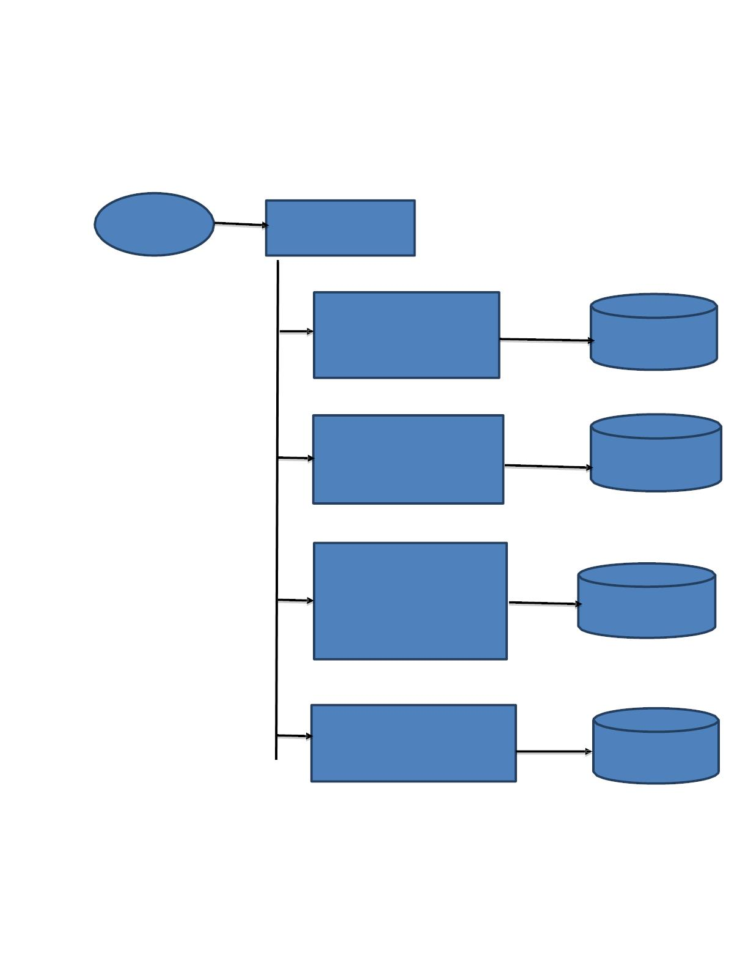
recorded. The user then register his personal details and the details of the land.
ADMIN
ADMIN
LOGIN
USERNAME AND PASSWRD IS
VALID
VIEW DEALER INFORMATION
DISPLAY
DATABASE
VIEW FORMER INFORMATION
DISPLAY
DATABASE
ADD SOIL REPORT ADD LEAF
DISEAS REPORT
APPROVE
DATABASE
Step 2: Soil Analysis
PREDICTION REPORT
DATABASE
The soil test report will be analyzed in this step. The nature of
the soil, nutrients present in it, will be

Slide 16
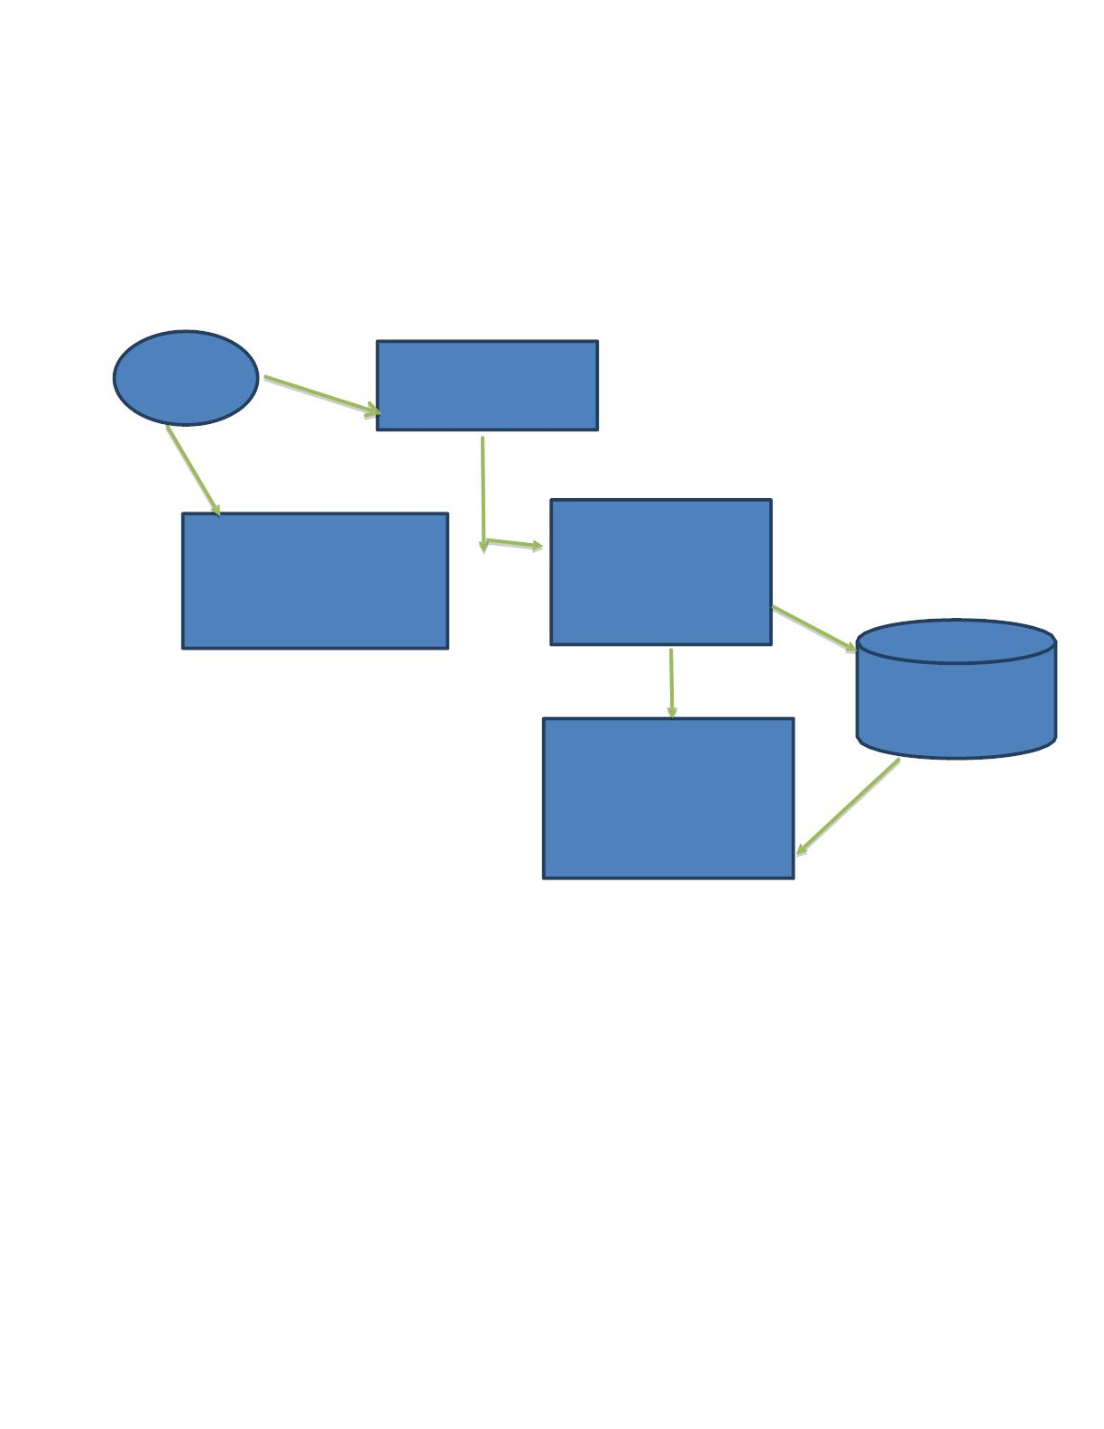
analyzed. Based on this analysis, fertilizers will be predicted
accordingly.
FRMERS
CHECKINPUT
FORMER
LOGIN
VIEW
VIEW MANUFACTURE
DATE
REGISTER
VIEW
DATABASE
VIEW PURCHASING
PLACE
Step 3: Leaf Disease Identification
In this step, the leaf disease present in the corresponding crop will be analyzed and the data will be
recorded.
Step 4: Prediction of the fertilizer through comparing and classification
In order to carry out the classification process, the data from the soil report was compared with the data
stored in the database using Long or Short Term Memory algorithm. Finally, the fertilizers are predicted
relevant to
the soil type.

Slide 17
FINDING EVALUATION:
The proposed
The authors proposed a new approach for the soil based fertilizer prediction system.
system was able to analyze the soil nutrient type efficiently, kind of leaf disease present in the crop and
predict the
fertilizer in a proficient manner. The approach was flexible, and can be extended to the needs of the
users in a better
manner. The proposed method was carried out with five different crops. As a future work, the method
can be
extended to include diverse varieties of crops to be cultivated and to analyze its performance.
ADVANTAGES:
Can improve crop behaviour ofpants
Efficient land use.
Cheap improving soil culture.
DISADVANTAGES:
Can make soilless fertile over time.
Fertilizer can contribute t sil pollution.
It may not cntain primary nutrients(nitrogen,potassium)
S.NO:5
YEAR:2022

Slide 18
AUTHOR NAME:
Sultana, J., Siddique, M. N. A. and Abdullah, M. R.
PROJECT TITLE:
Fertilizer recommendation for Agriculture: practice, practicalities and
adaptation in Bangladesh and Netherlands
ABSTART:
For maintaining of soil quality and attainable crop yield, it is required to add proper amount of
fertilizers and minimize the misuse of soil resources which is possible by knowing actual situation
of soil physical, chemical and biological condition through observation, investigation and soil
testing. Soil test is an imperative tool for assessing the fertilizer or manure requirement for
sustainable production of crops and for sustaining soil fertility. Soil test and subsequent fertilizer
recommendation was pioneered and provided to farmers by the Soil Resource Development
Institute (SRDI), Ministry of Agriculture, Bangladesh. SRDI is conducting soil sample analysis in
static and mobile laboratories.
DESIGN METHODOLOGY:
Methods of extraction
N (%) Kjeldahl method
Organic C (%) Wet oxidation method
P (μg/g) Modified oslen method (Neutral+ Calcareous soil)
P (μg/g) Bray and Kurtz method (acid soil)
S (μg/g) Calcium dihydrogen phosphate extraction
K (m eq/100g) NNH4OAC Method

Slide 19

FINDING FOR EVALUTION:
Most of the tests for evaluation of packaging materials are based mainly on evaluation of one or
other type of strength of packaging material .
FERTILITY EVALUATION BY PLANT ANALYSIS Plant analysis is a useful diagnostic tool to ascertain
if a nutrient has been or is being assimilated.
Soil fertility evaluation Soils are very heterogeneous in respect to forms of nutrients they contain,
which greatly complicates the interpretation of Soil Test for assessing fertilizer
ADVANTAGS:
Increases fertilizer use efficiency
Reduses leanching
Resulting in better growth
DISADVANTAGS:
Over usage can damage plants.
It affects the environment and ecosystem.
It is toxic and can harm humans.

Slide 20


